Slide 1
URBAN REDEVELOPMENT
NEW BRUNSWICK PERSPECTIVES:
New Brunswick Redevelopment – Gateway & Rutgers
Christopher J. Paladino
President, New Brunswick Development Corporation

Slide 2
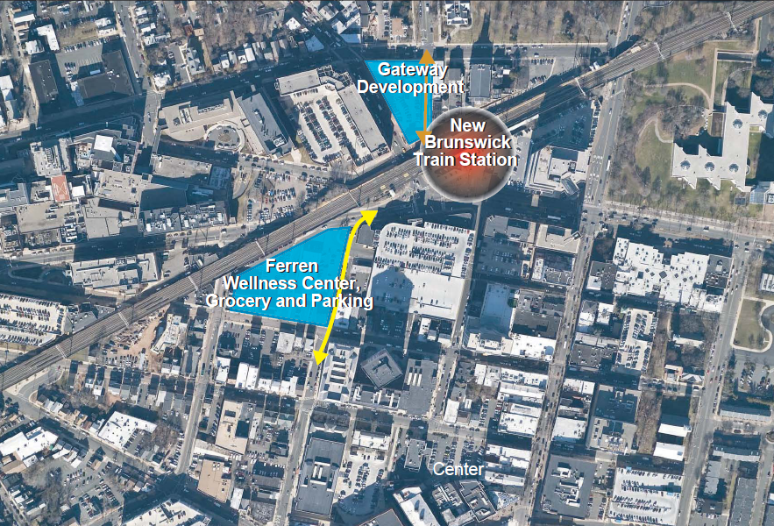

Slide 4
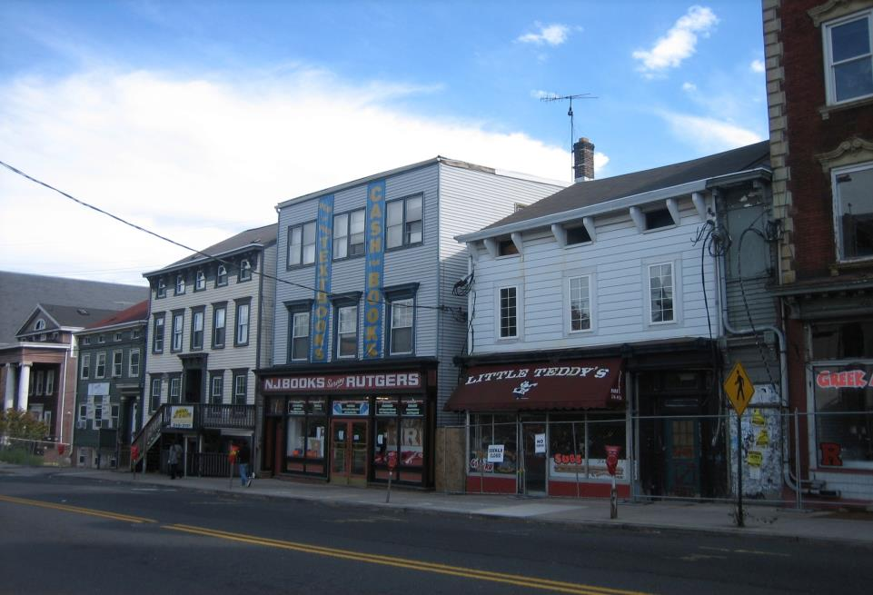

Slide 5
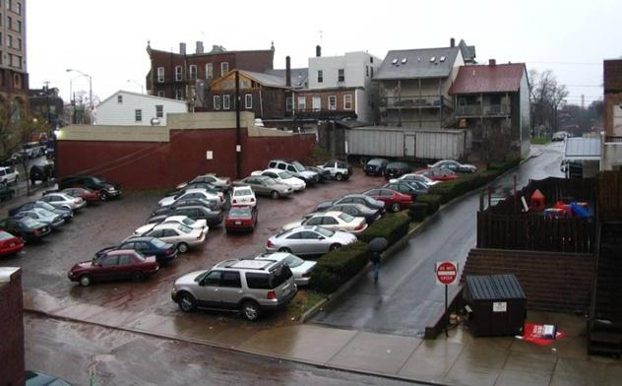

Slide 6
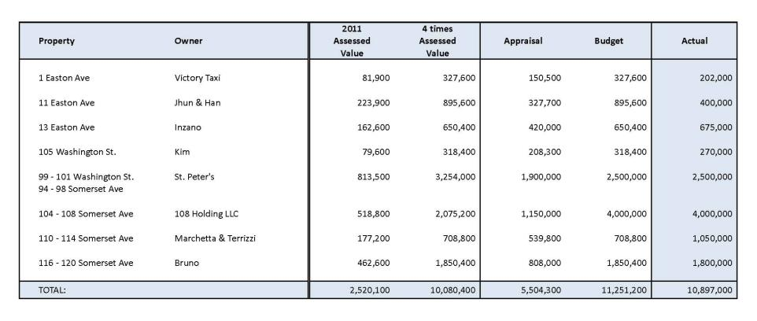
Acquisition Cost

Slide 7
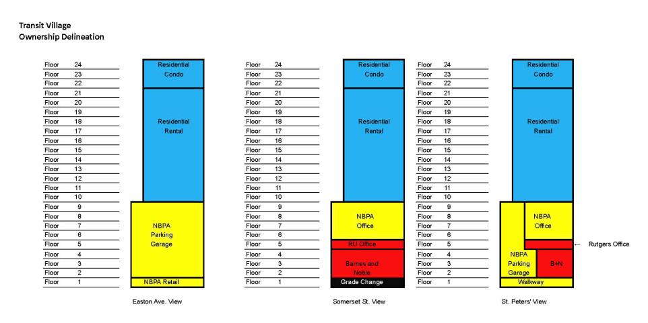
Ownership Delineation

Slide 8
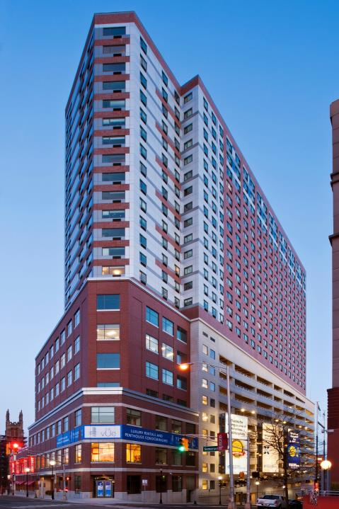

Slide 9
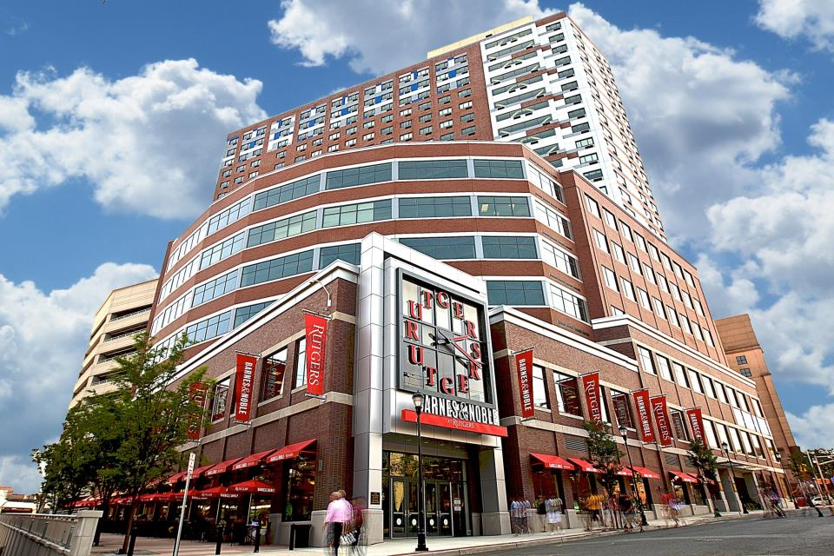

Slide 10
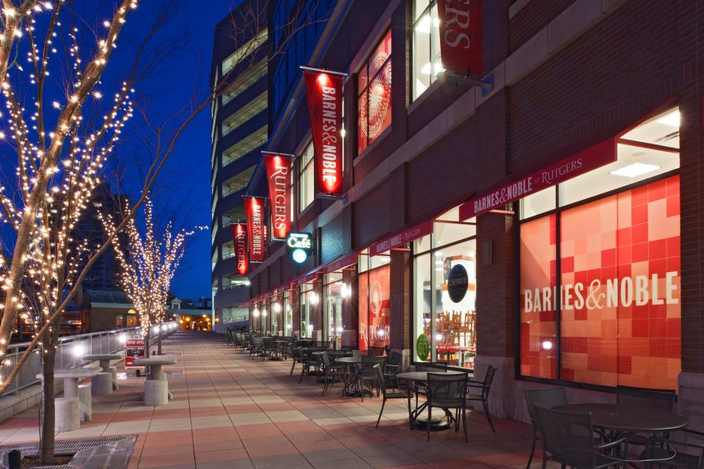

Slide 11
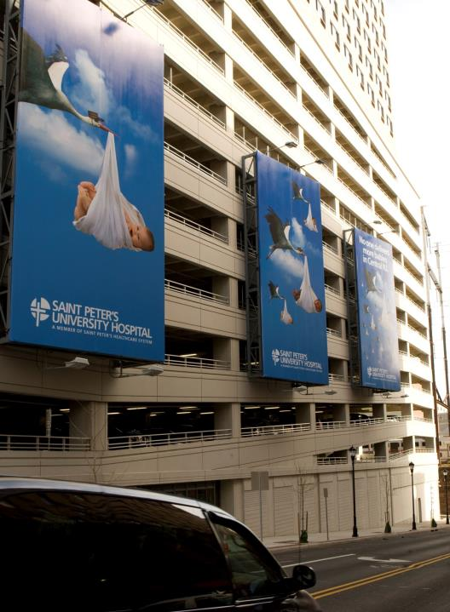

Slide 12
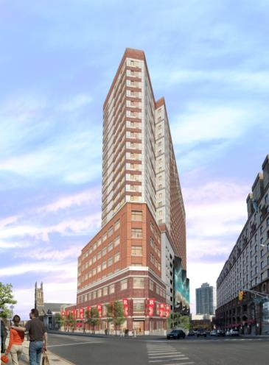
New Brunswick Transit Village
Residential Condo
TICIC
Magyar Bank
Developer Equity
Residential Rental
Bank of America - First Mortgage
Bank of America – NMTC Mortgage
NMTC Tax Credit Proceeds (BOA)
NMTC Tax Credit Proceeds (Citi, Wells, RBC, & NJCC)
UTHTC Proceeds (TD Bank)
UTHTC Proceeds (MetLife)
Developer Equity
Rutgers University
Bond Debt
New Brunswick Parking Authority
Build America Bonds
NJDOT Transportation Funds ($1m/year for 10 years)
Total Project Sources
9,040,000
600,000
2,990,000
12,630,000
8,287,500
10,612,500
4,387,500
9,604,300
20,532,498
7,214,809
1,922,140
62,561,247
16,080,000
48,866,745
10,000,000
150,137,992

Slide 13
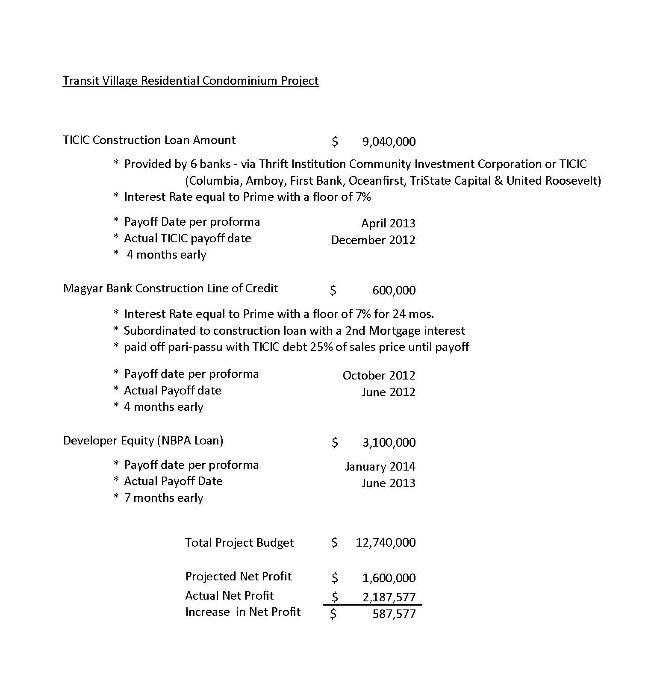

Slide 14
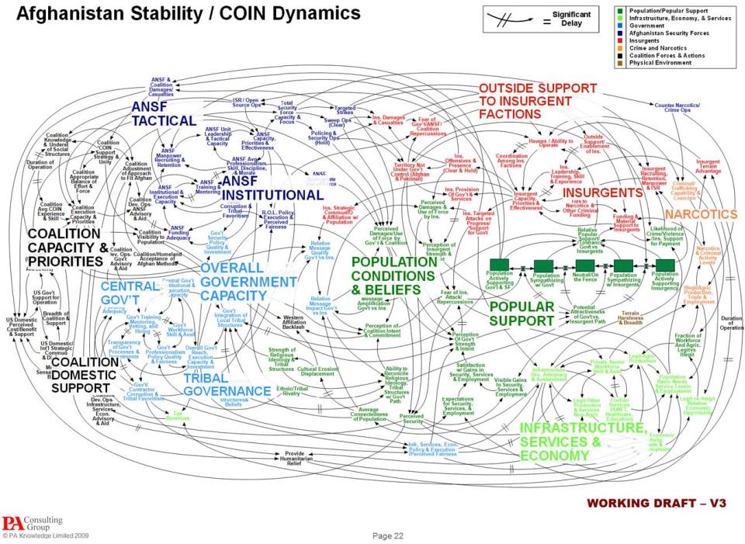

Slide 15
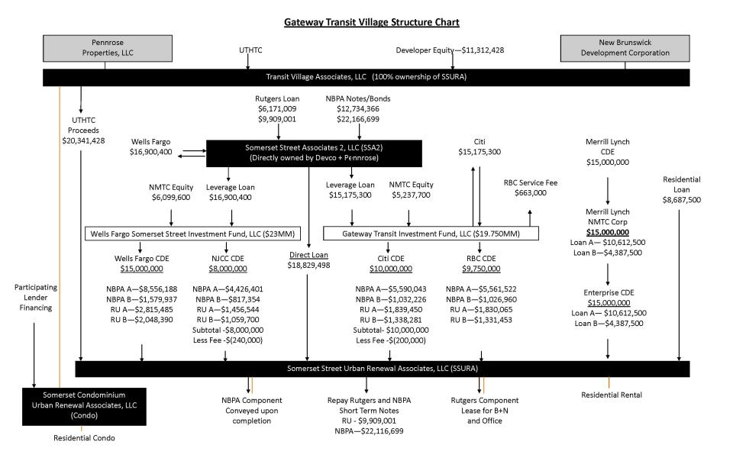

Slide 16
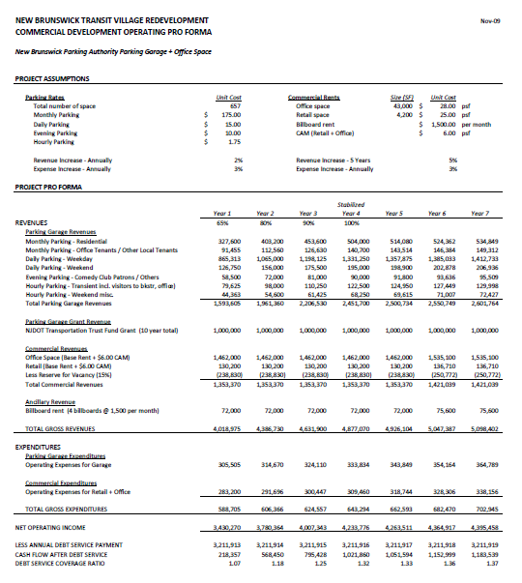

Slide 17
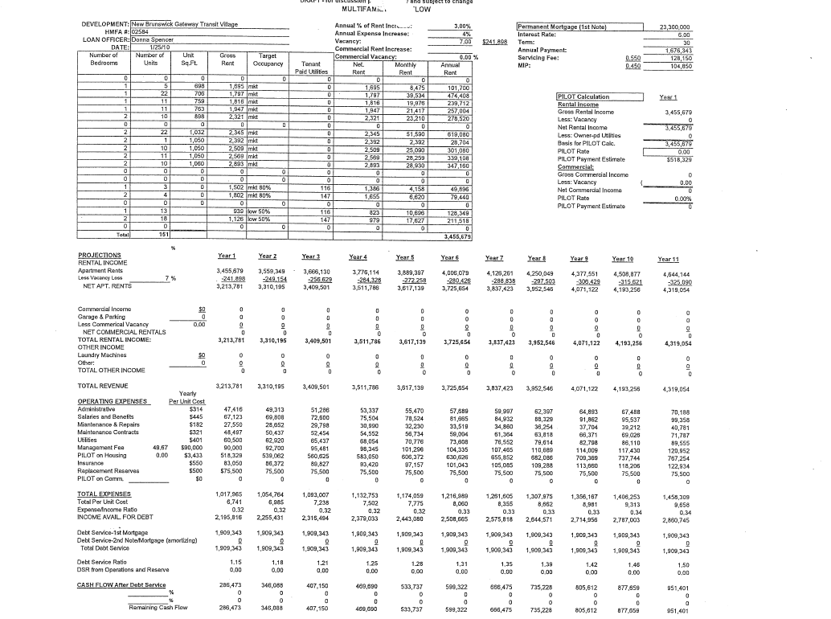

Slide 18
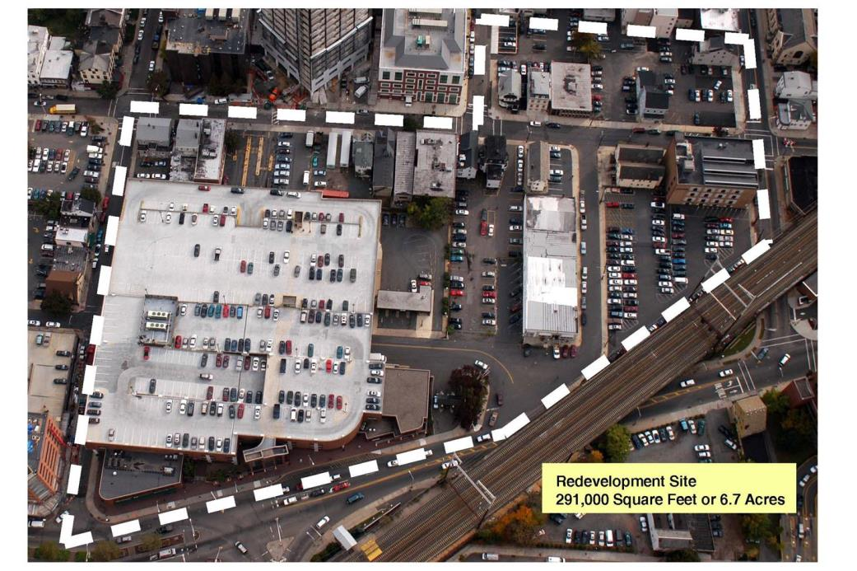

Slide 19
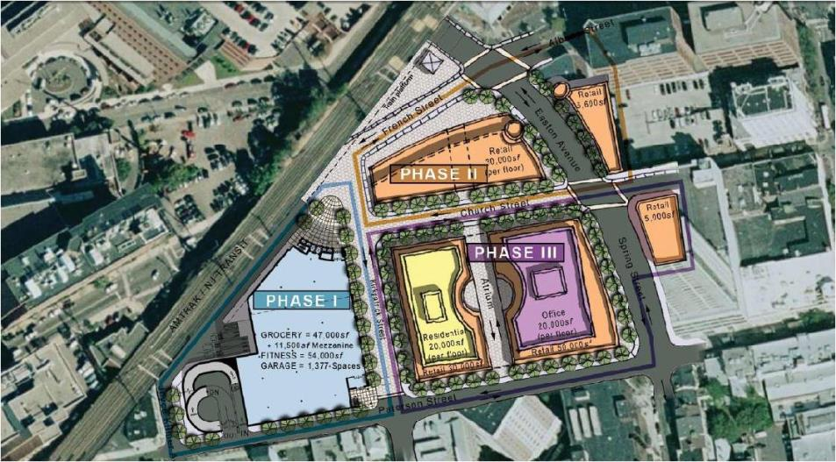

Slide 20
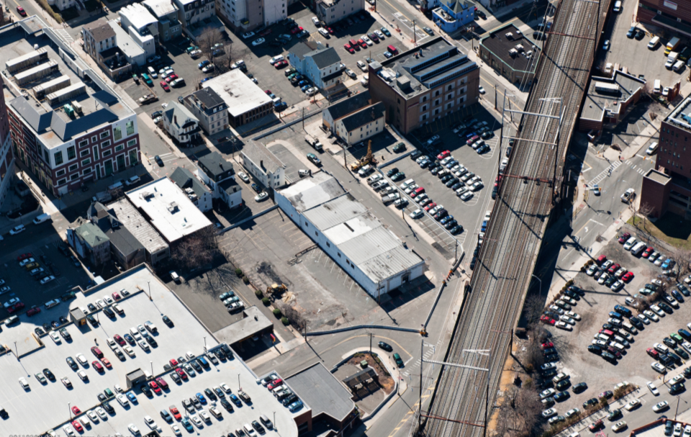

Slide 21
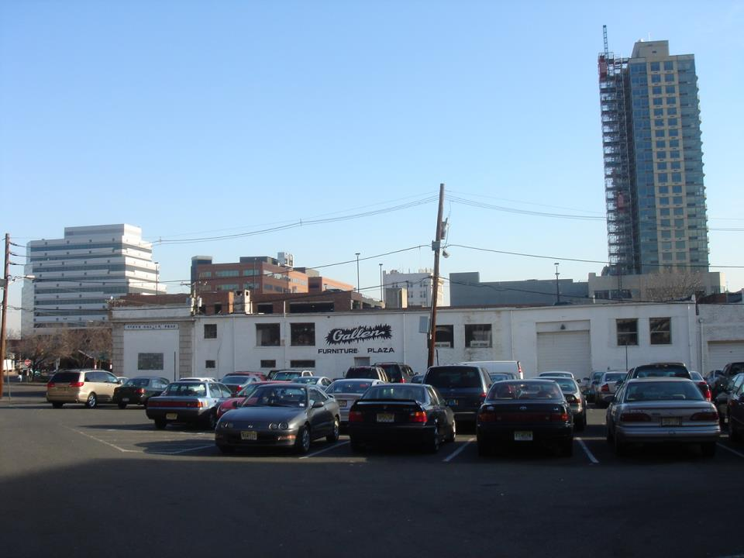

Slide 22
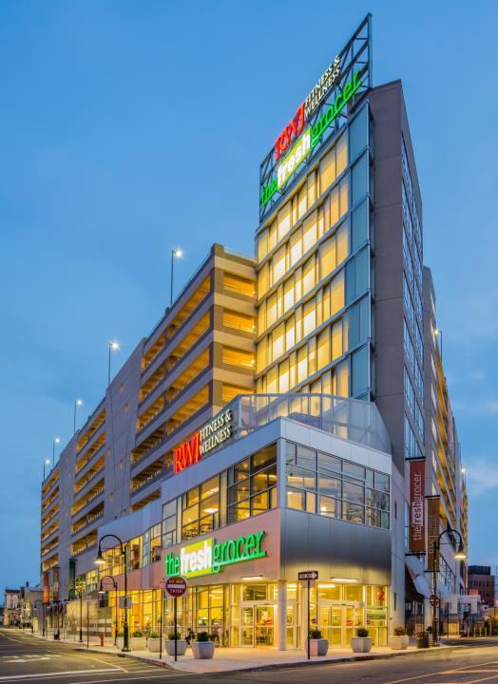

Slide 23

New Brunswick Wellness Plaza
Wellness Project Uses:
Supermarket
Fitness Center
Parking Garage
Total Project Uses:
Wellness Project Sources:
Parking Authority Bonds
-Recover Zone Facility Bonds
-Recovery Zone Economic Development Bonds
-Build America Bonds
Open Space Grant
Urban Transit Hub Tax Credit Proceeds
New Markets Tax Credit Proceeds
Total Project Sources
$16,006,774
24,227,087
66,292,678
$106,526,539
$24,600,000
26,200,000
41,544,239
3,000,000
3,500,000
7,682,300
106,526,539

Slide 24
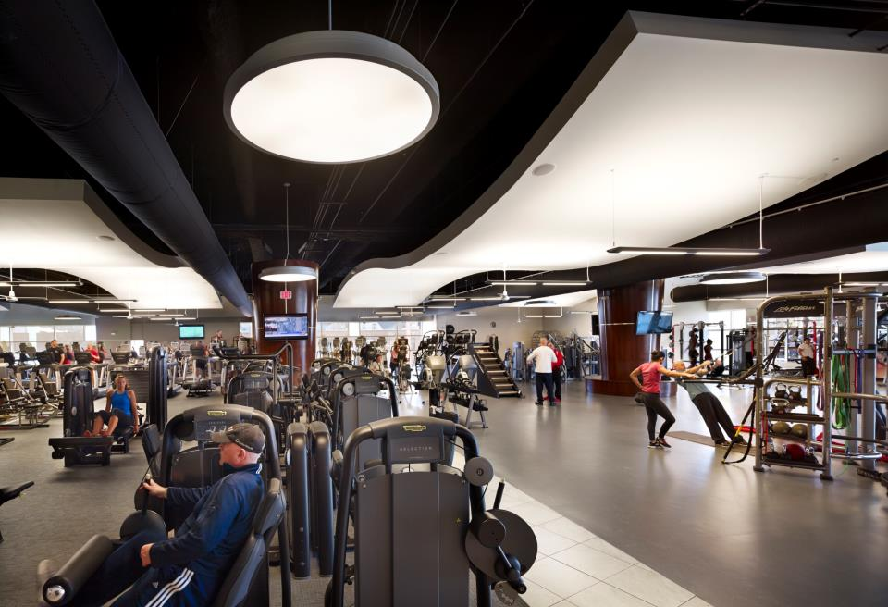

Slide 25
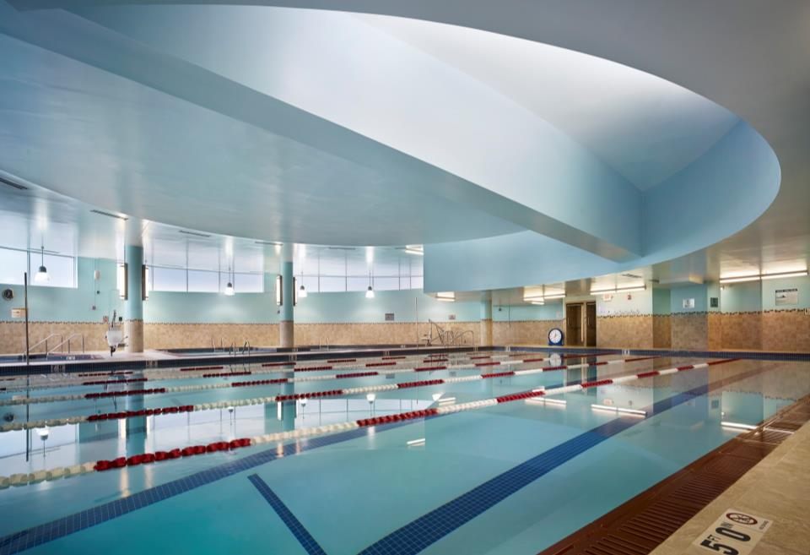

Slide 26
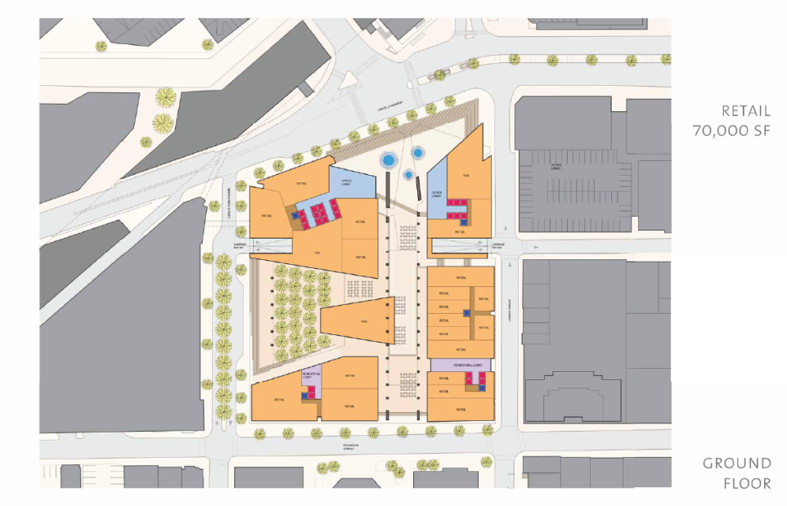

Slide 27
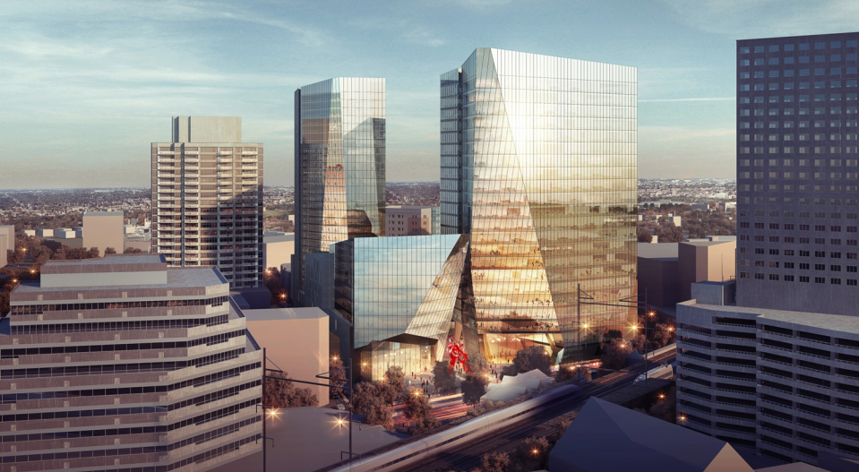

Slide 28
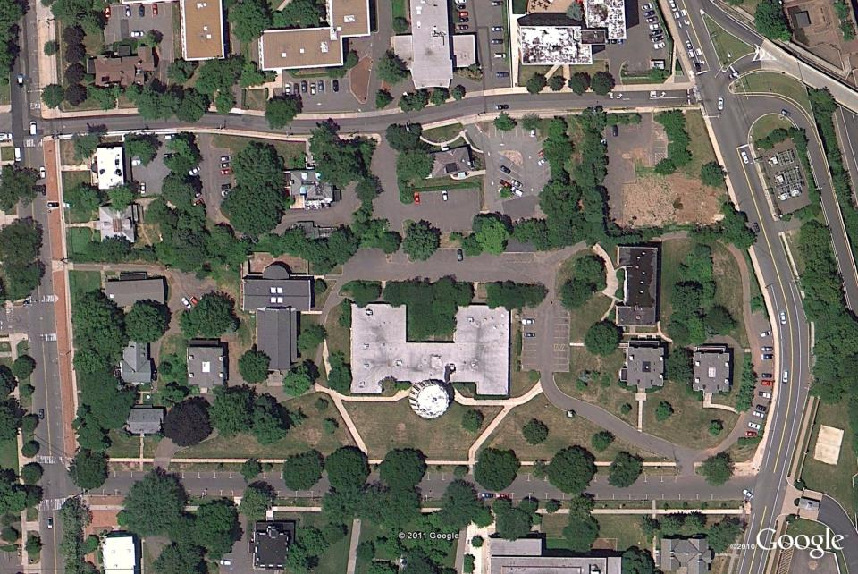

Slide 29
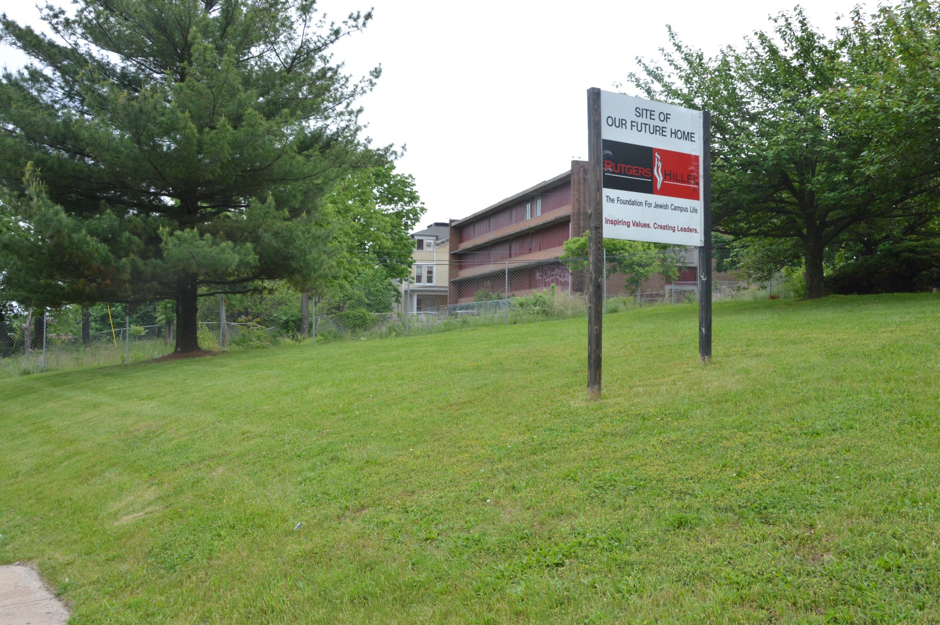
HC Before Housing

Slide 30
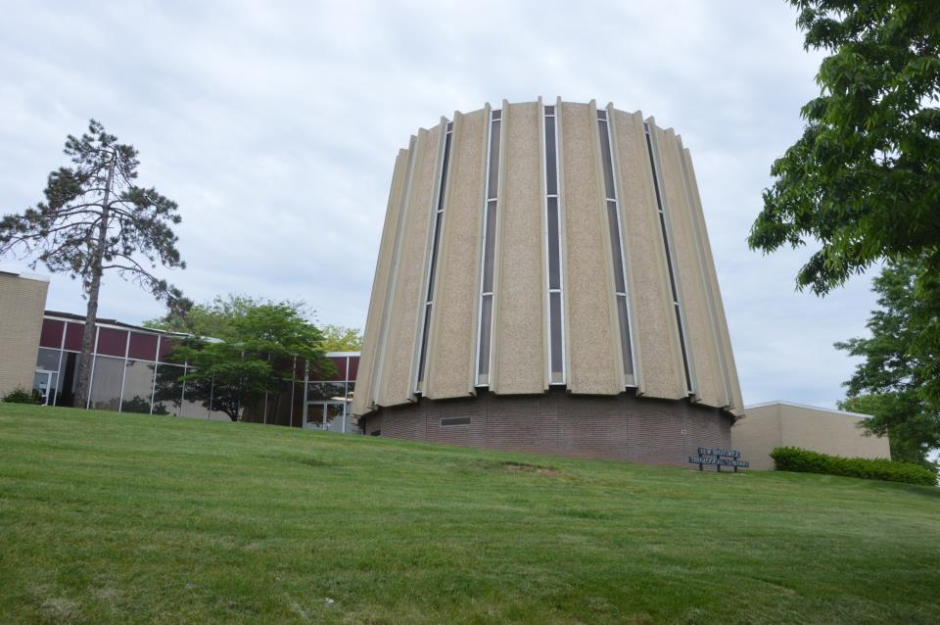

Slide 31
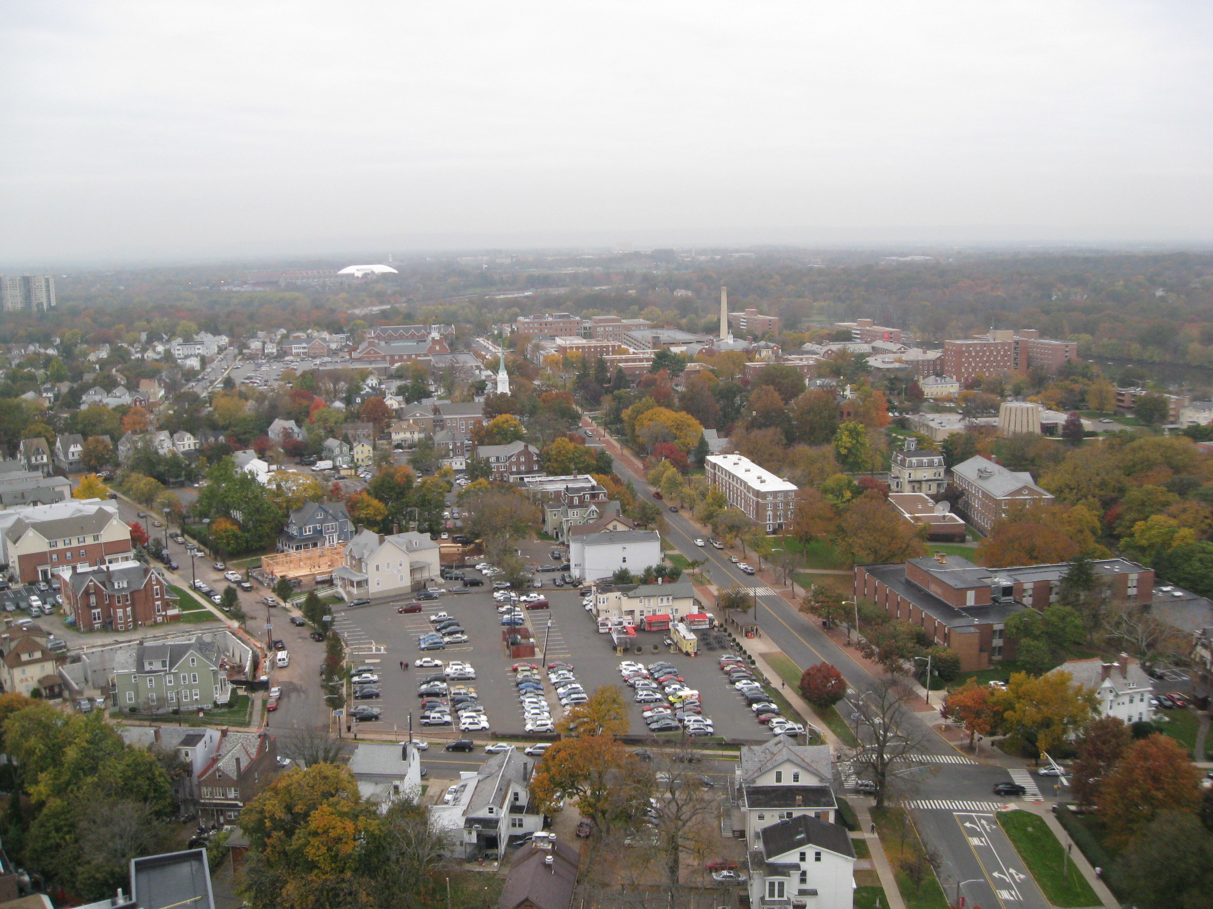

Slide 32
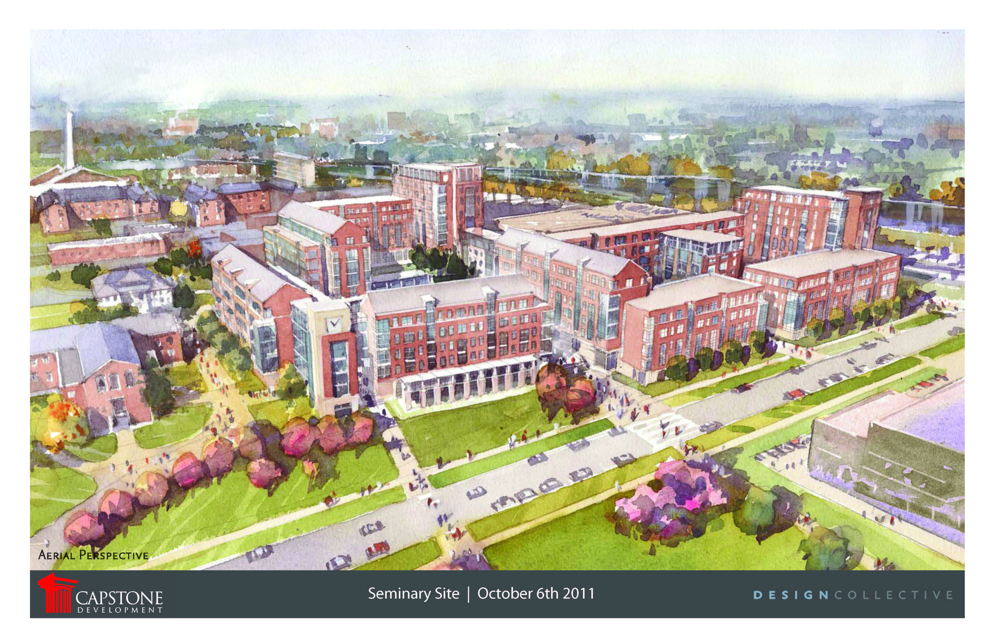

Slide 33
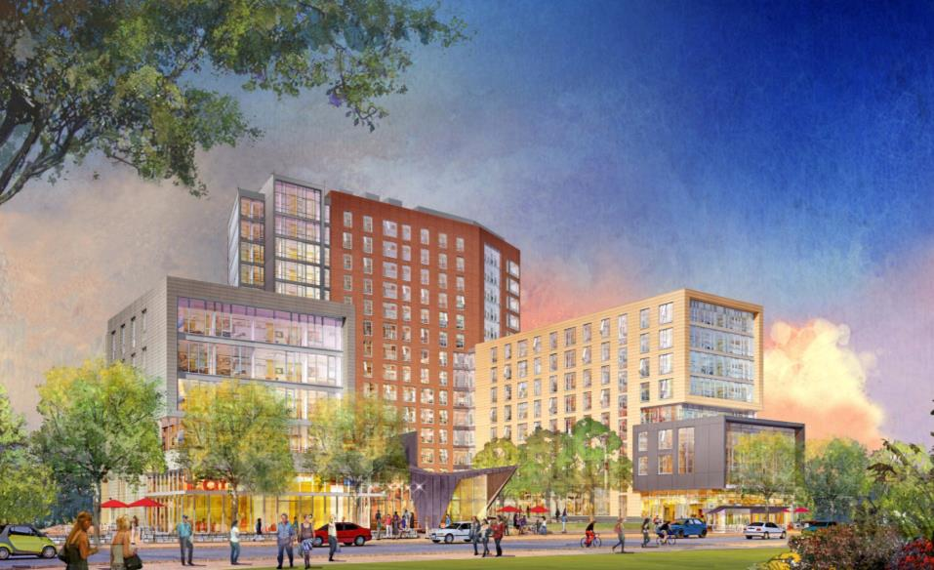

Slide 34
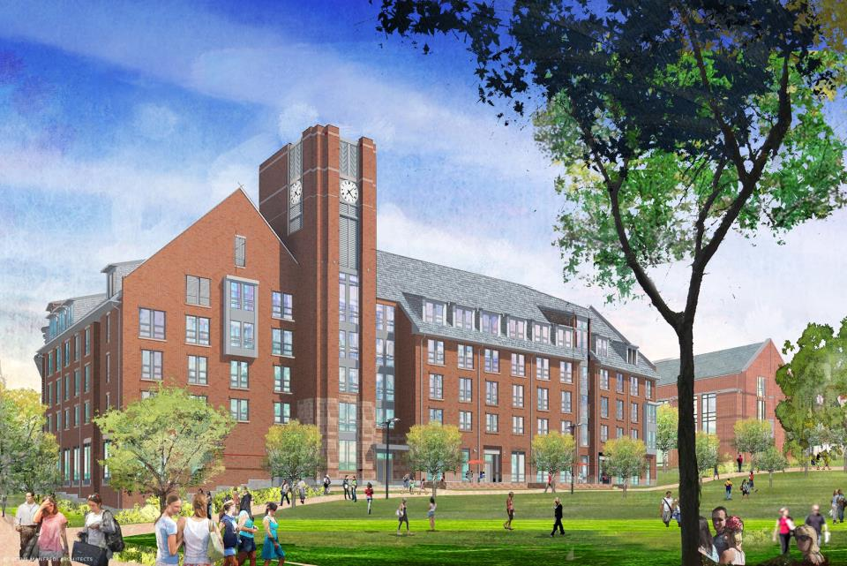

Slide 35
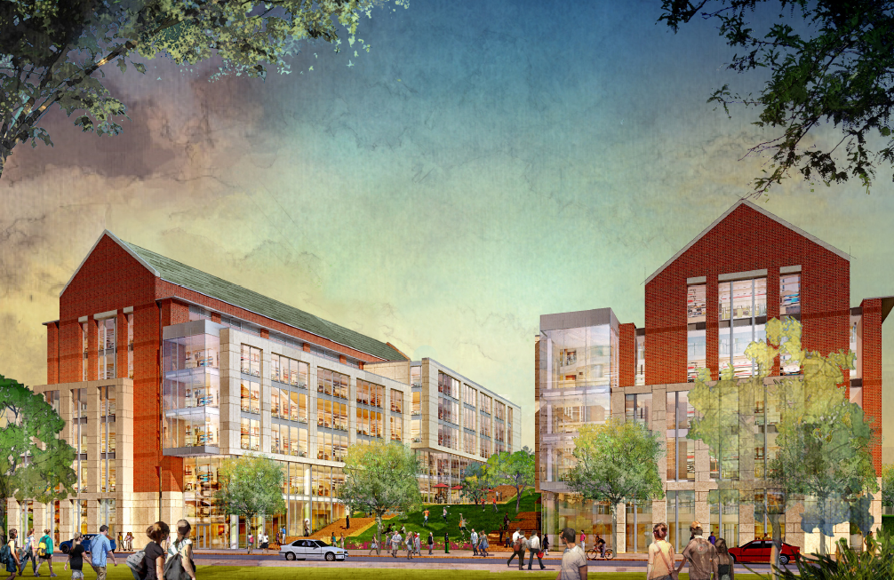

Slide 36
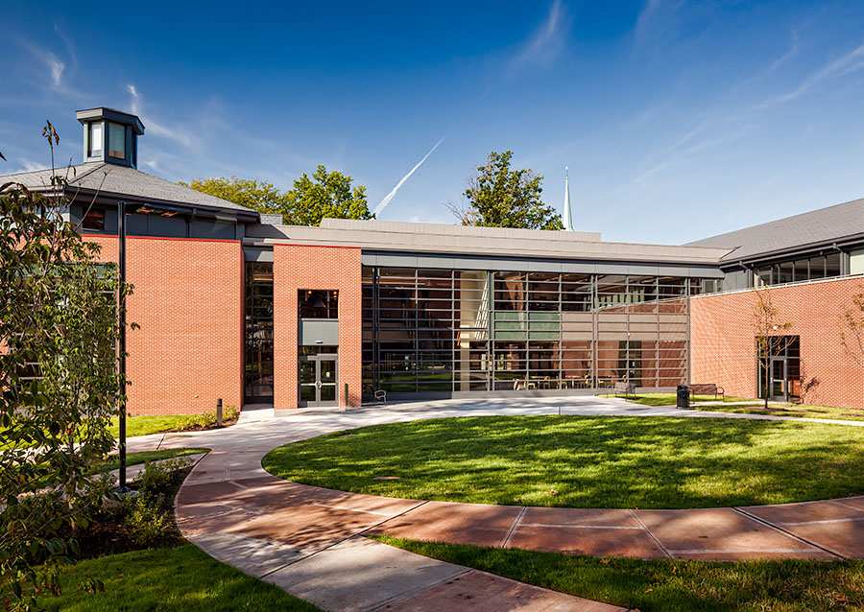

Slide 37
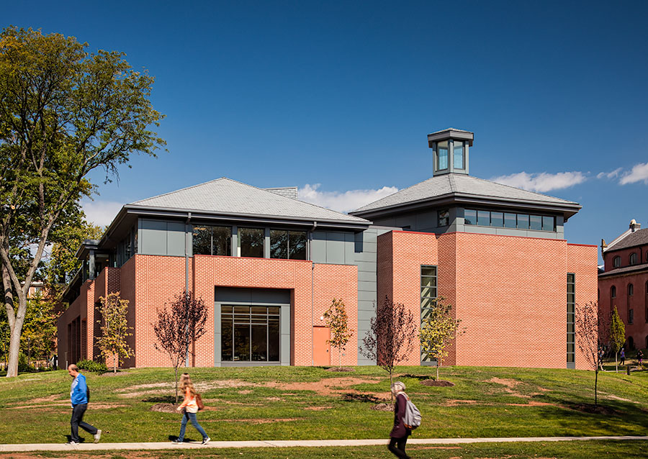

Slide 38
